Slide 1
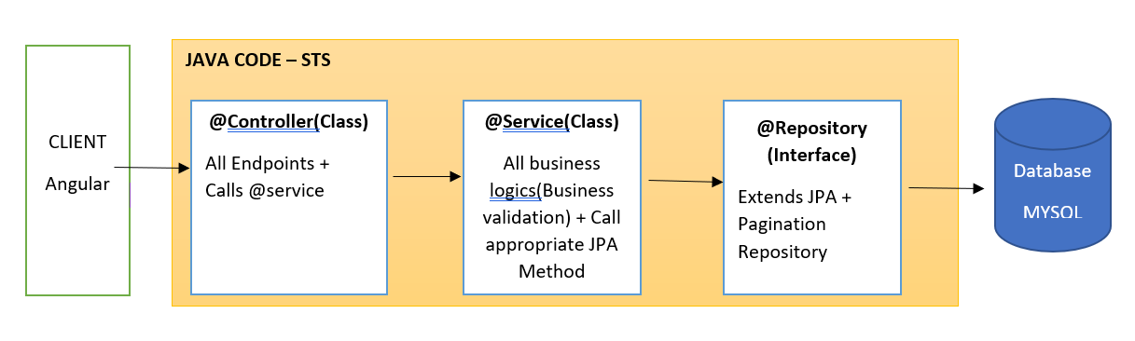
Use Case – CRUD for Banking application
Basic Architecture

Slide 2
Get endpoint – This endpoint will display the list of bank

Slide 3
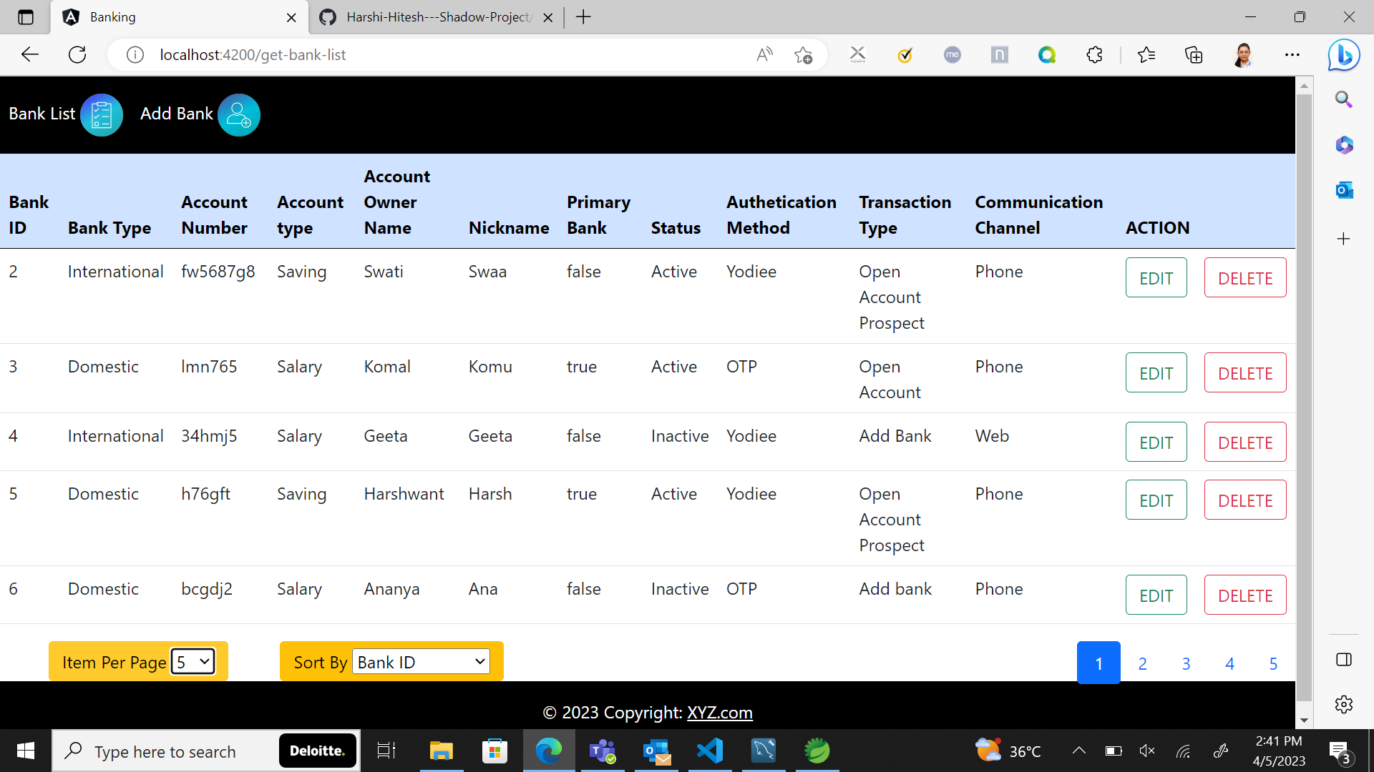

Slide 4
Pagination and Sorting
This display the bank list with respect to page size and
Sort-by functions .
Page size can be 5 8 and 10 respectively
Sorting can be done by bank id,name and account status

Slide 5
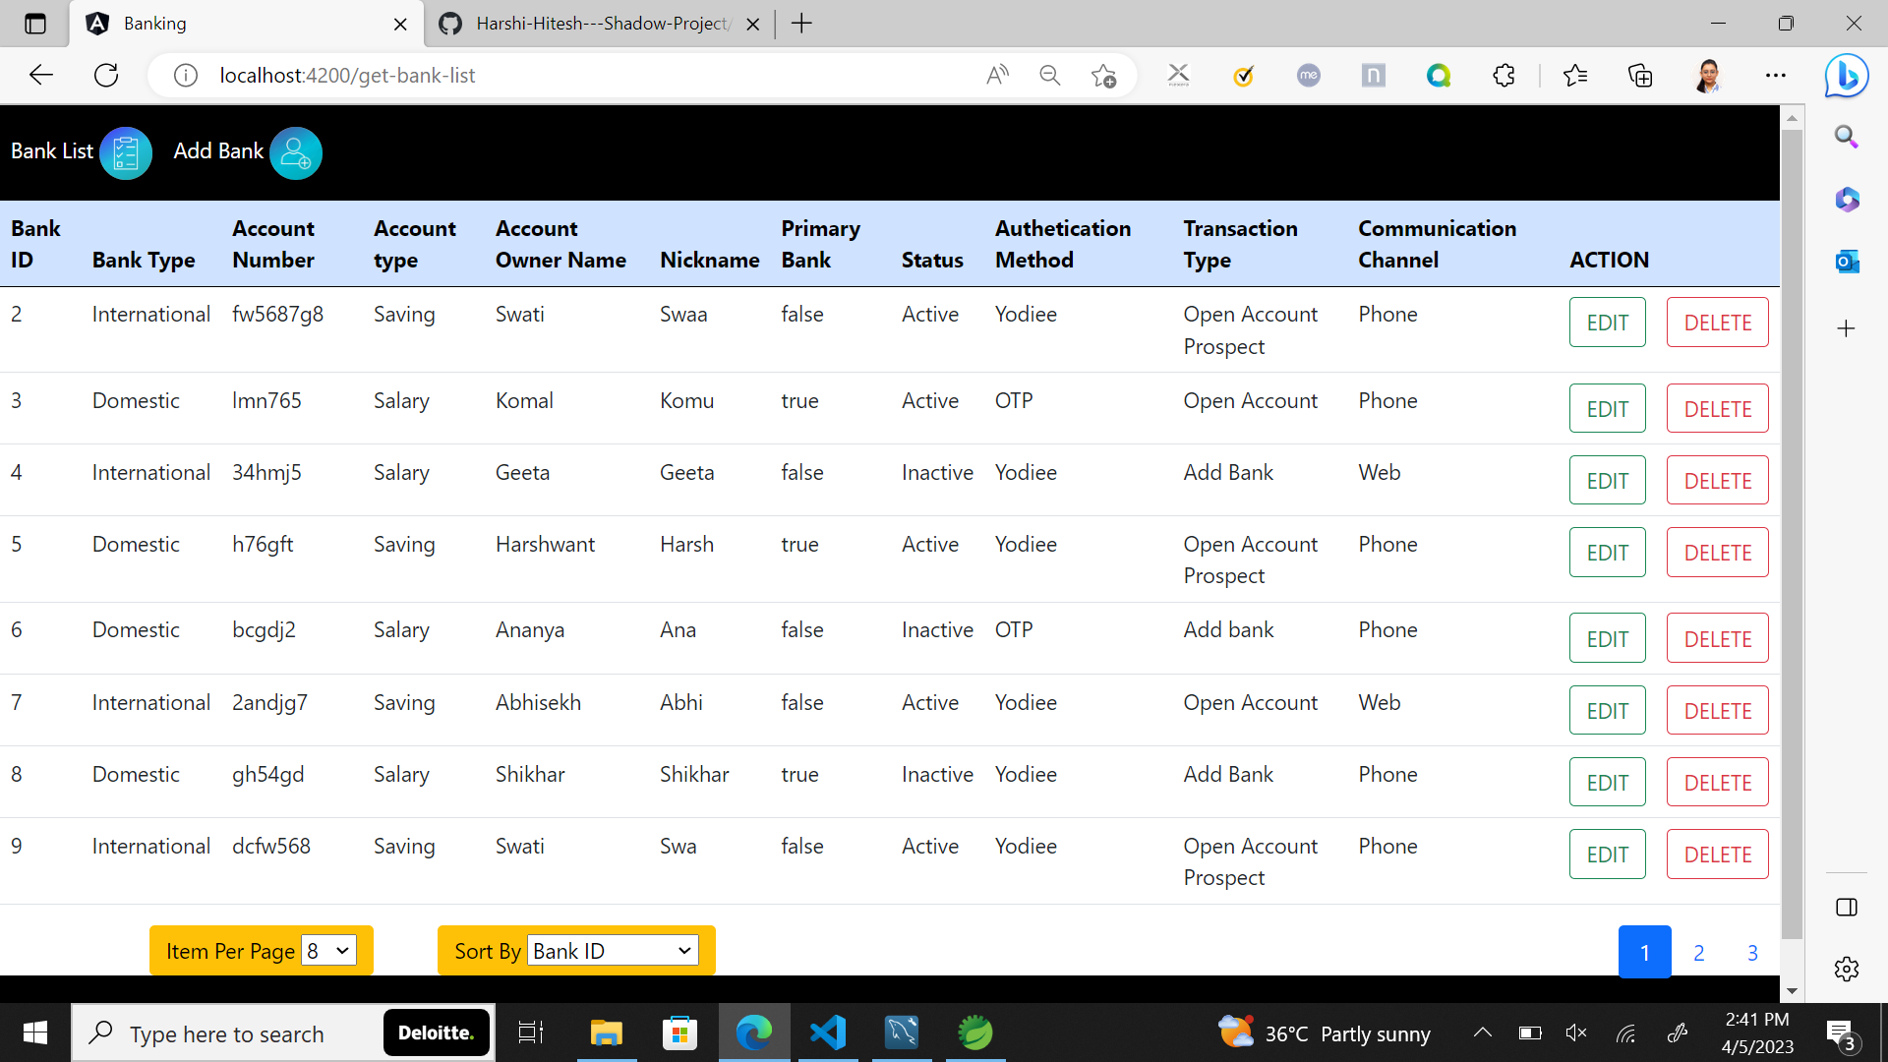
Page size 8 , sort by bankId

Slide 6
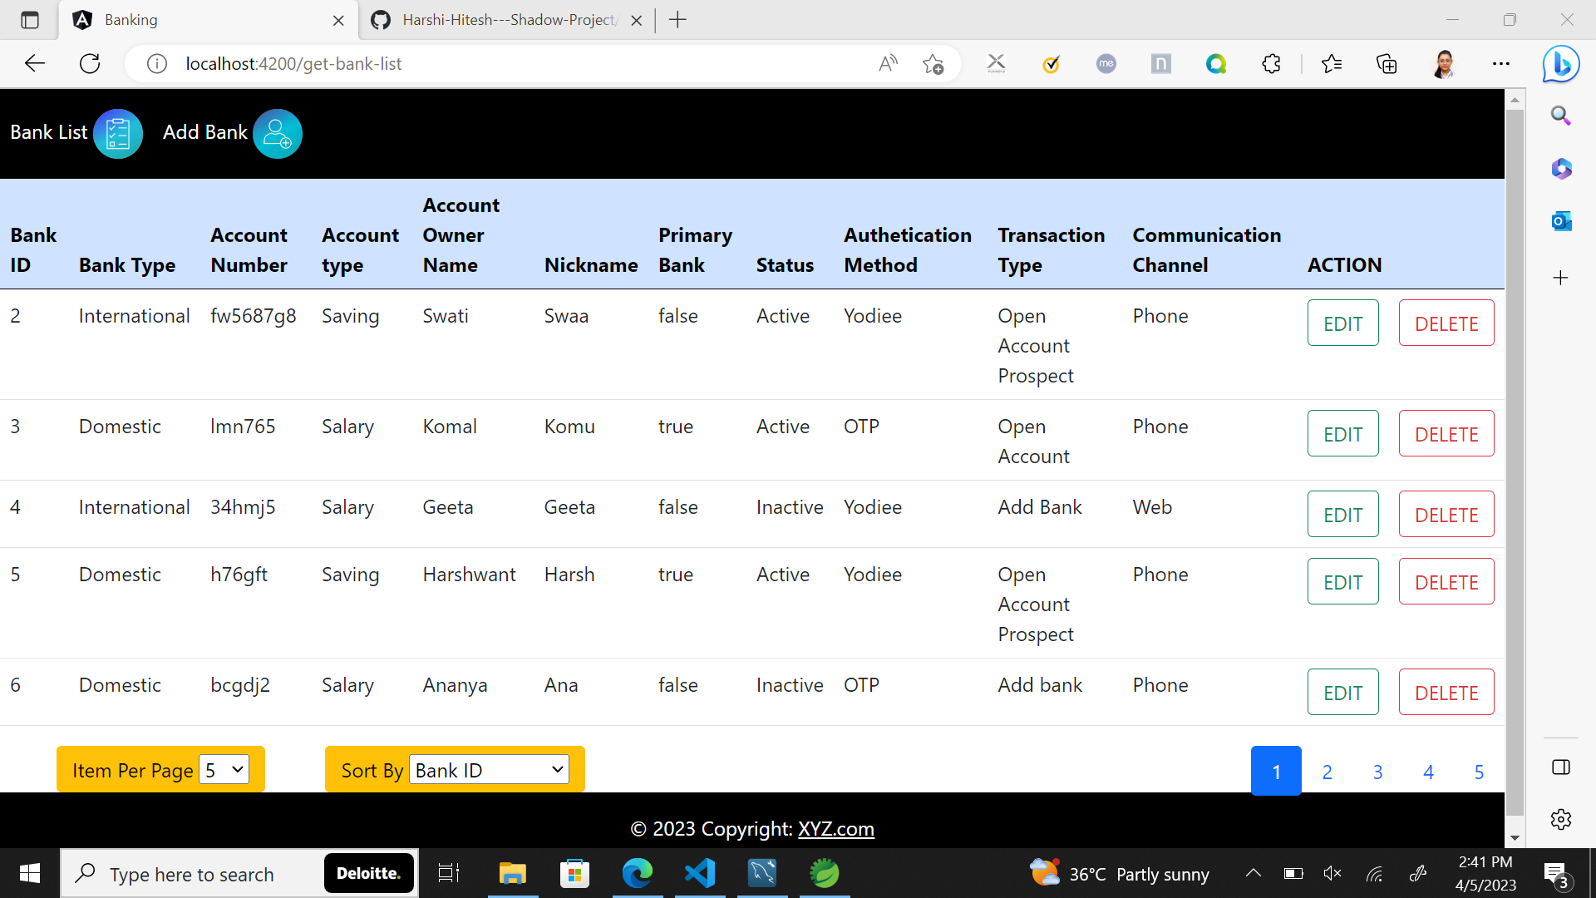
Page size 5 , sort by bankId

Slide 7
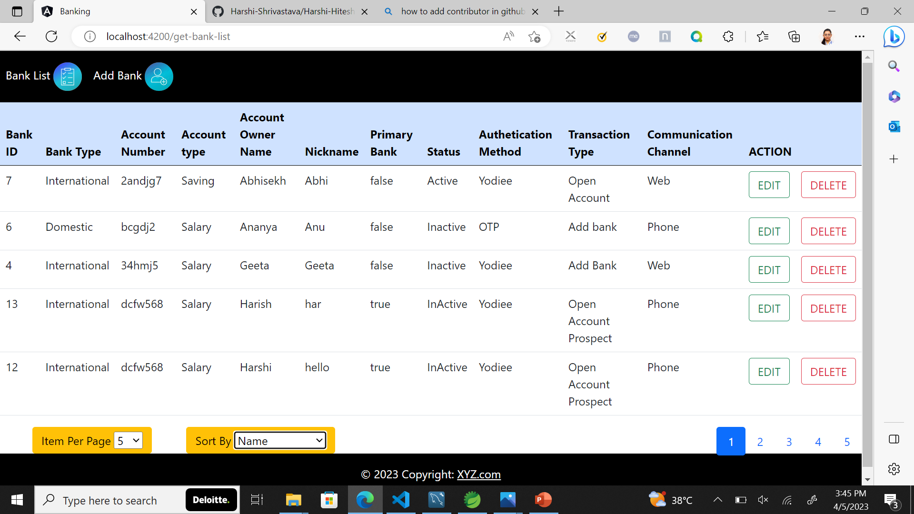
Page size 5 , sort by name

Slide 8
POST Endpoint -will enable user add bank details

Slide 9
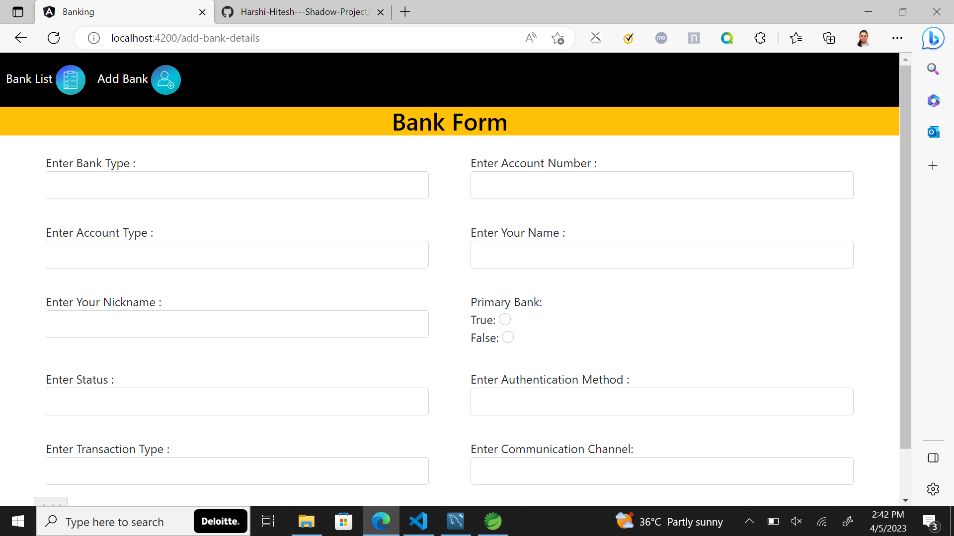

Slide 10
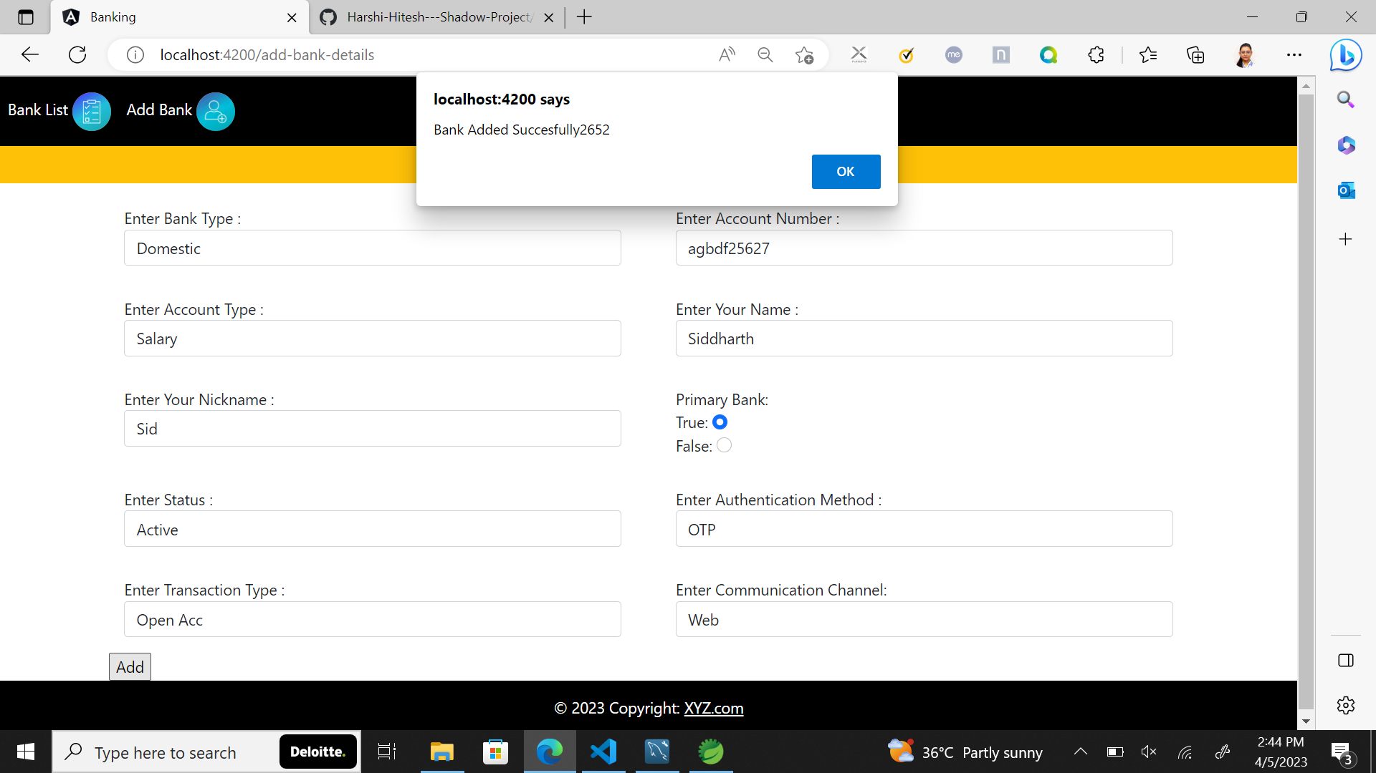

Slide 11
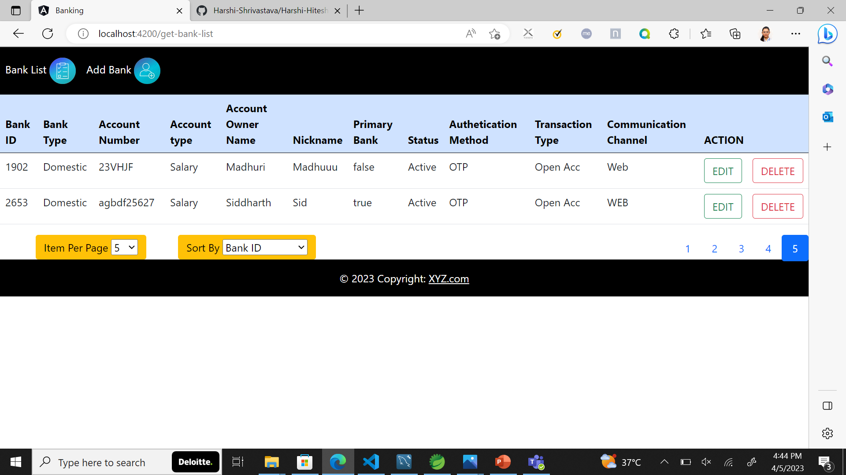
User added

Slide 12
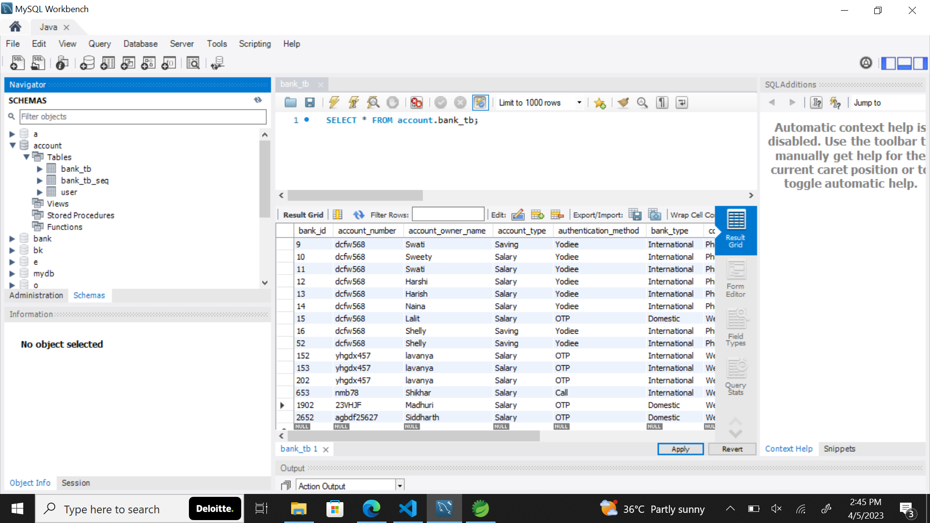
User added in database

Slide 13
PATCH Endpoint – This will unable user update the specific field.

Slide 14
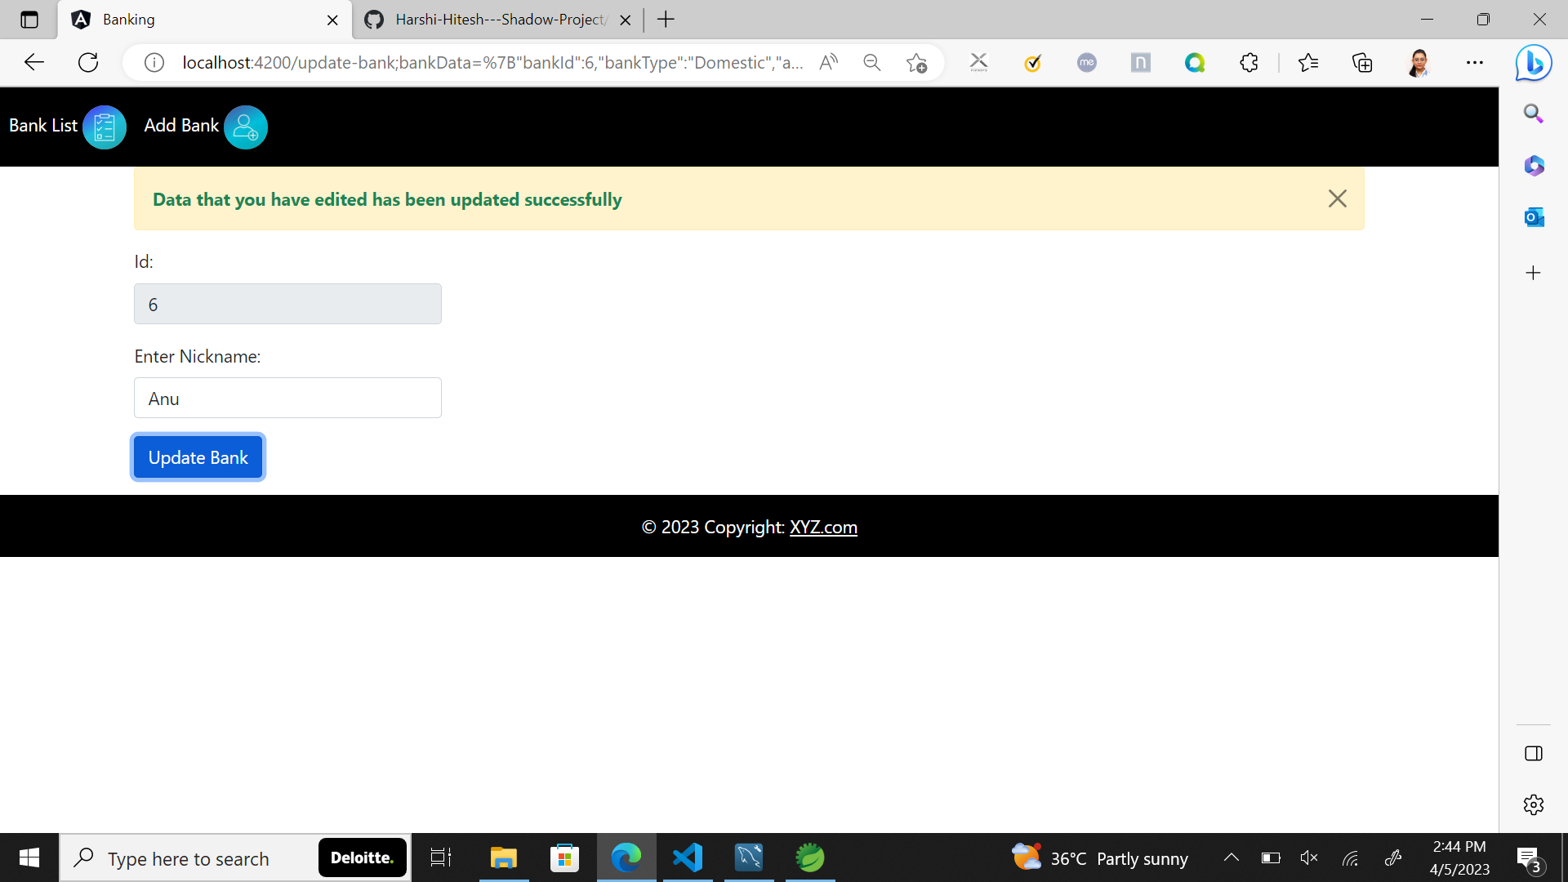

Slide 15
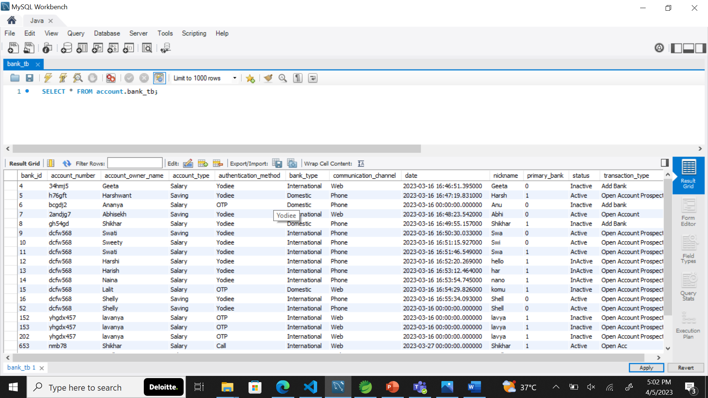
Nickname updated to Anu on database

Slide 16
DELETE Endpoint – This will delete the user from the list and database

Slide 17
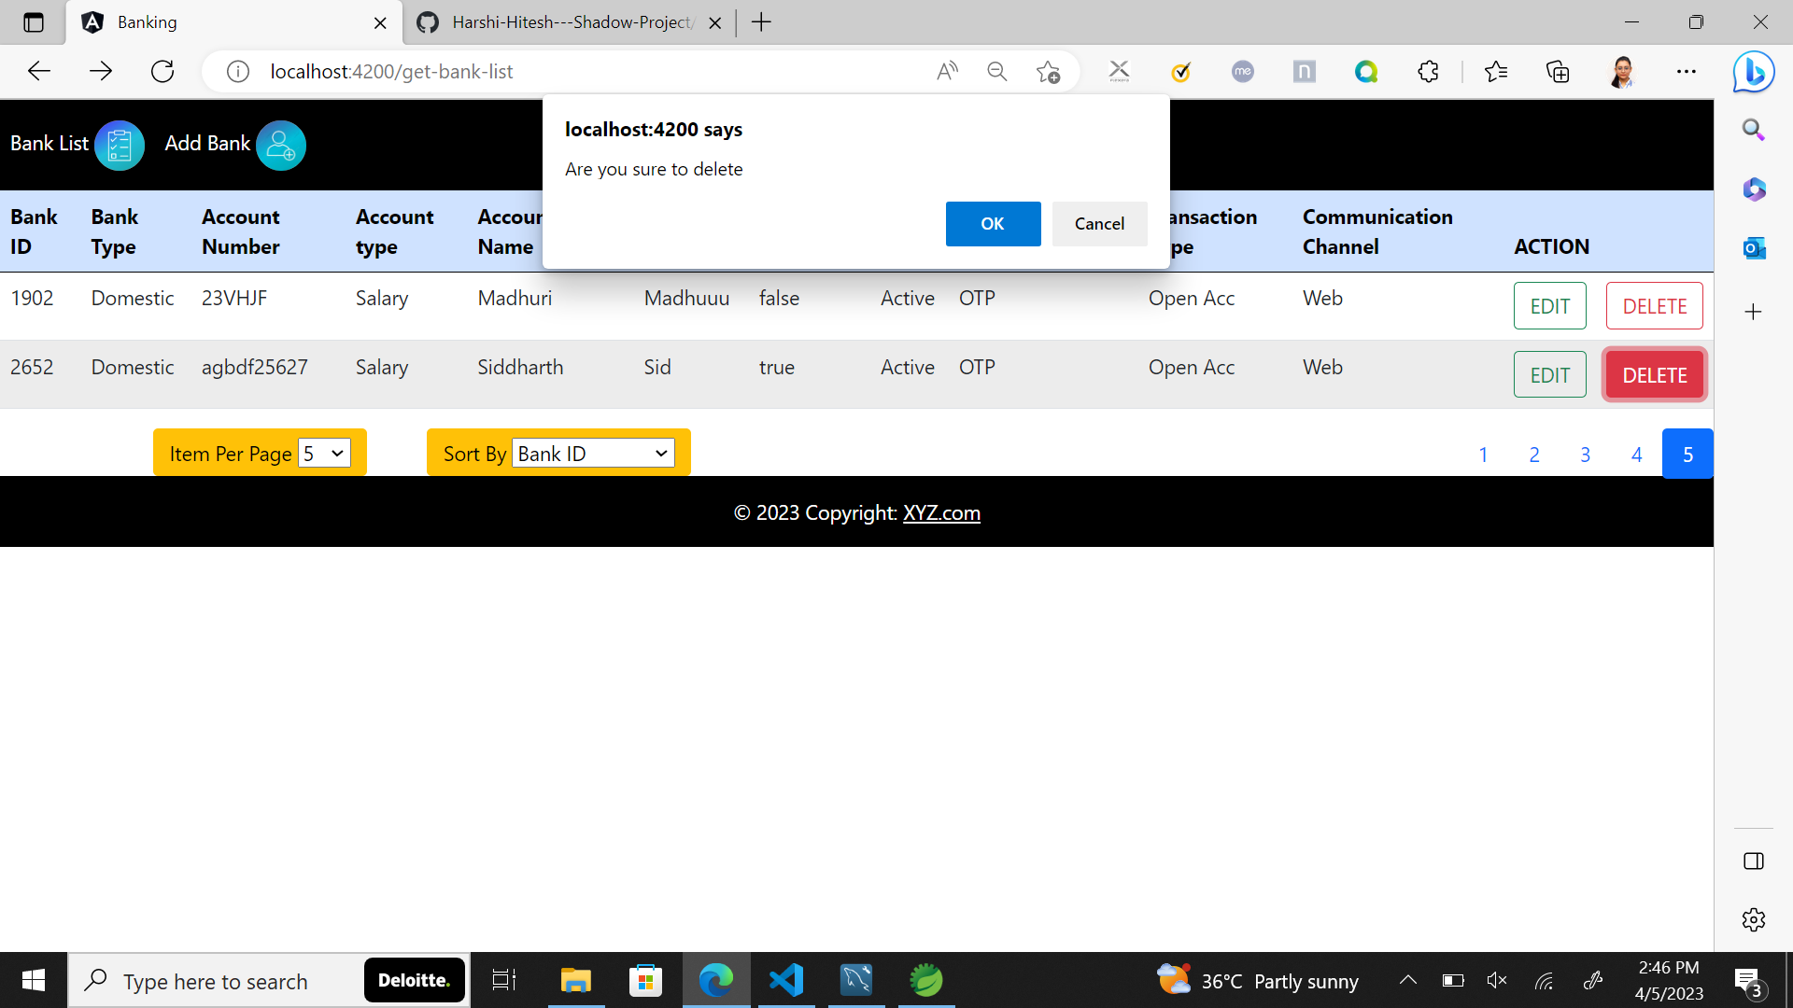

Slide 18
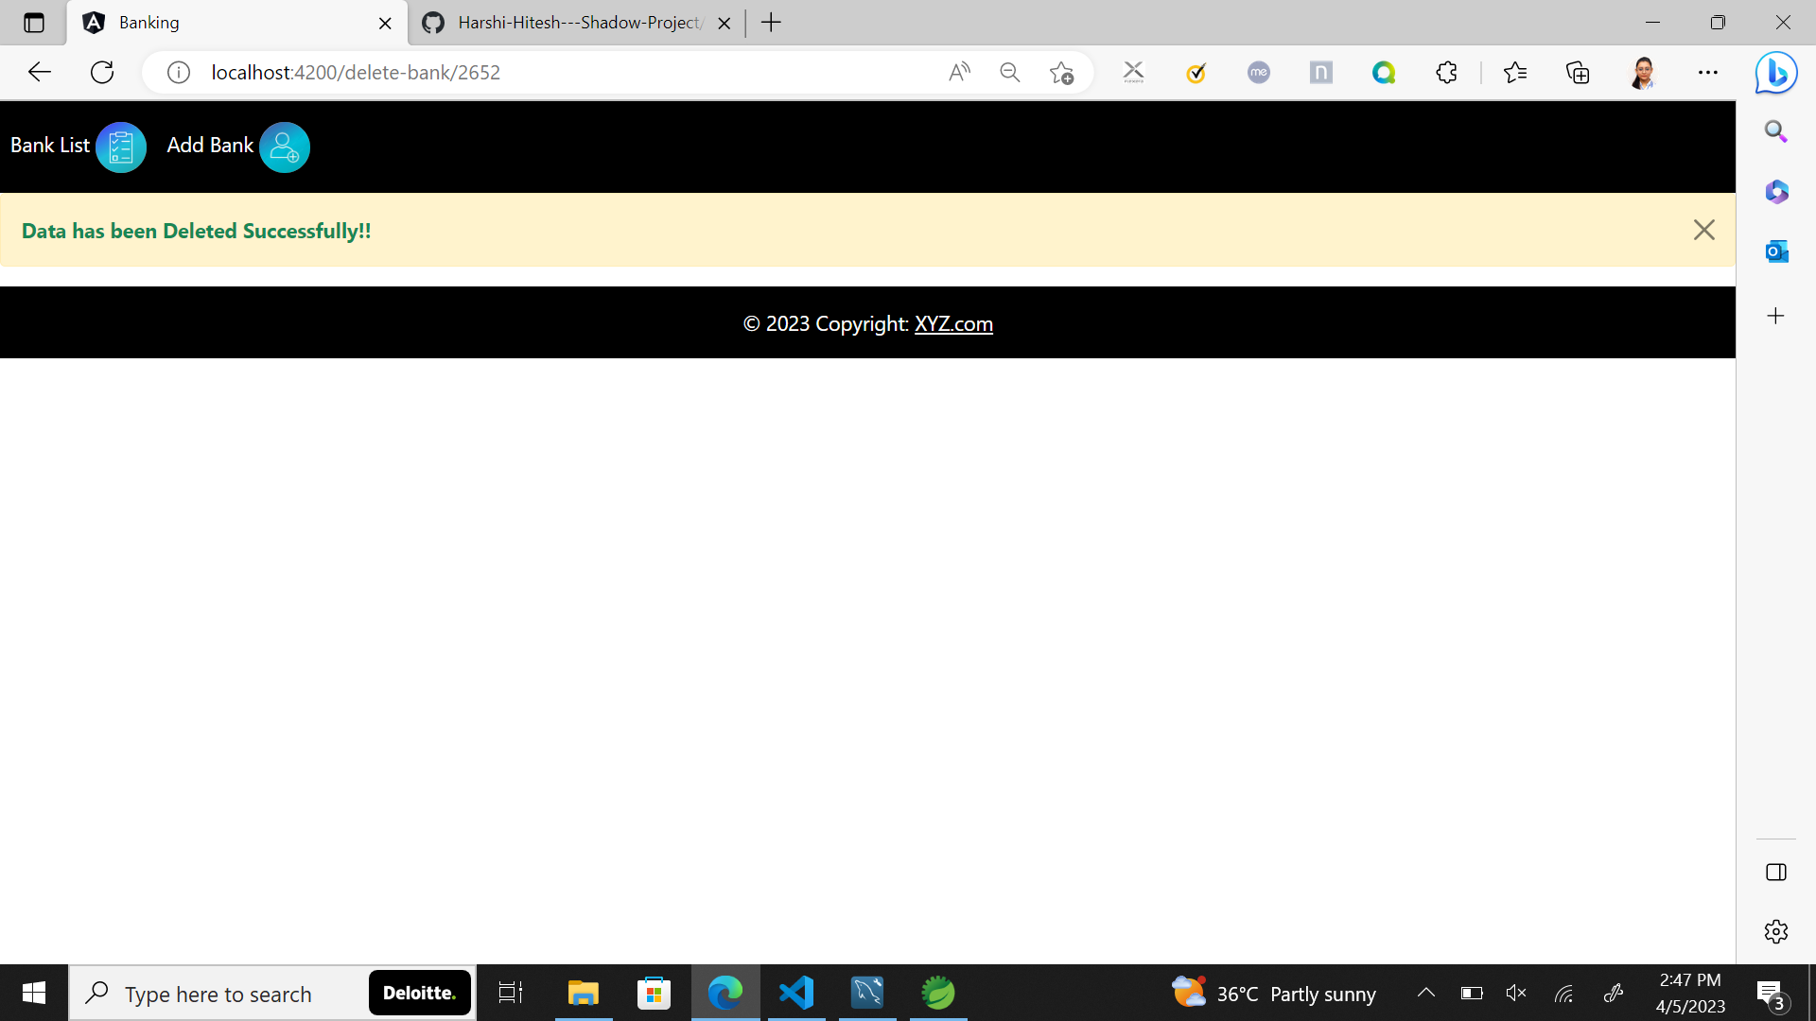

Slide 19
Structural Validations

Slide 20
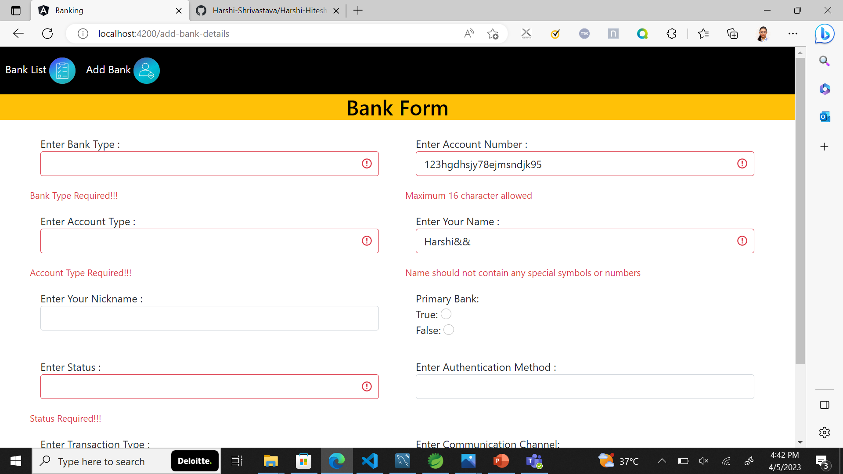

Slide 21
Business Validation

Slide 22
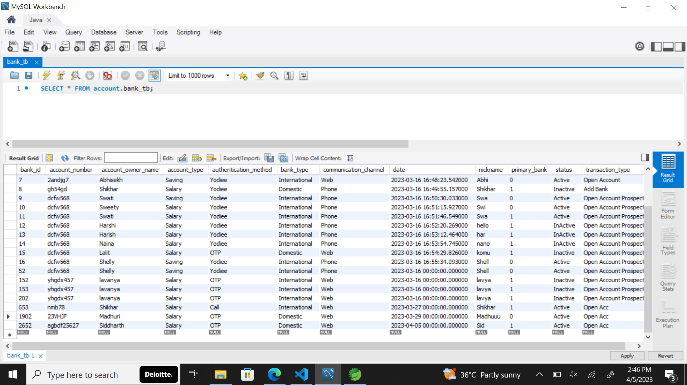
User cannot delete within 30 days- Response code 406

Slide 23
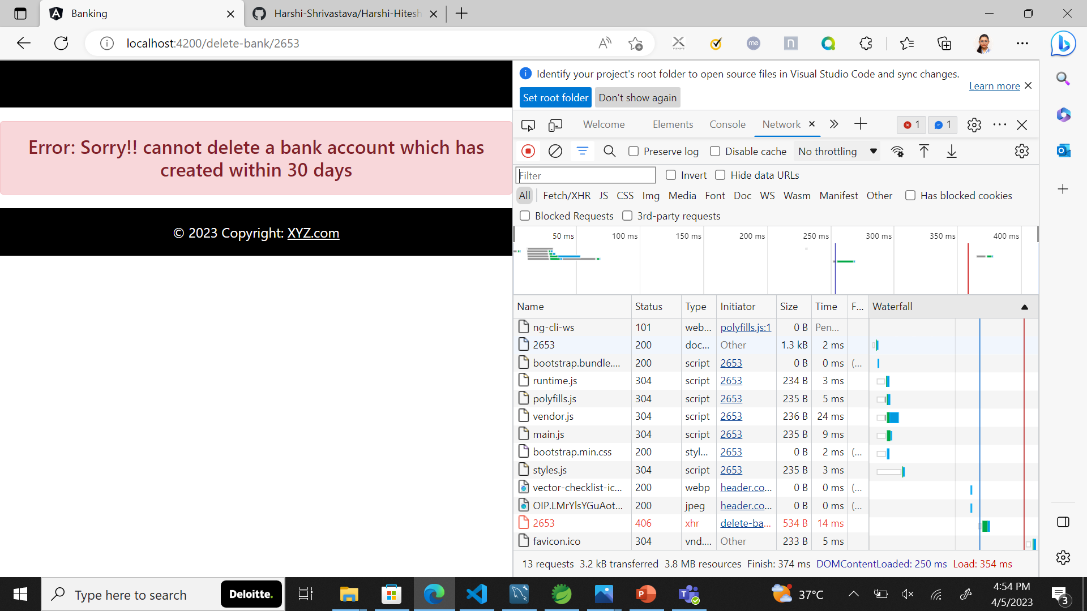
406 Response code – Not Acceptable

Slide 24
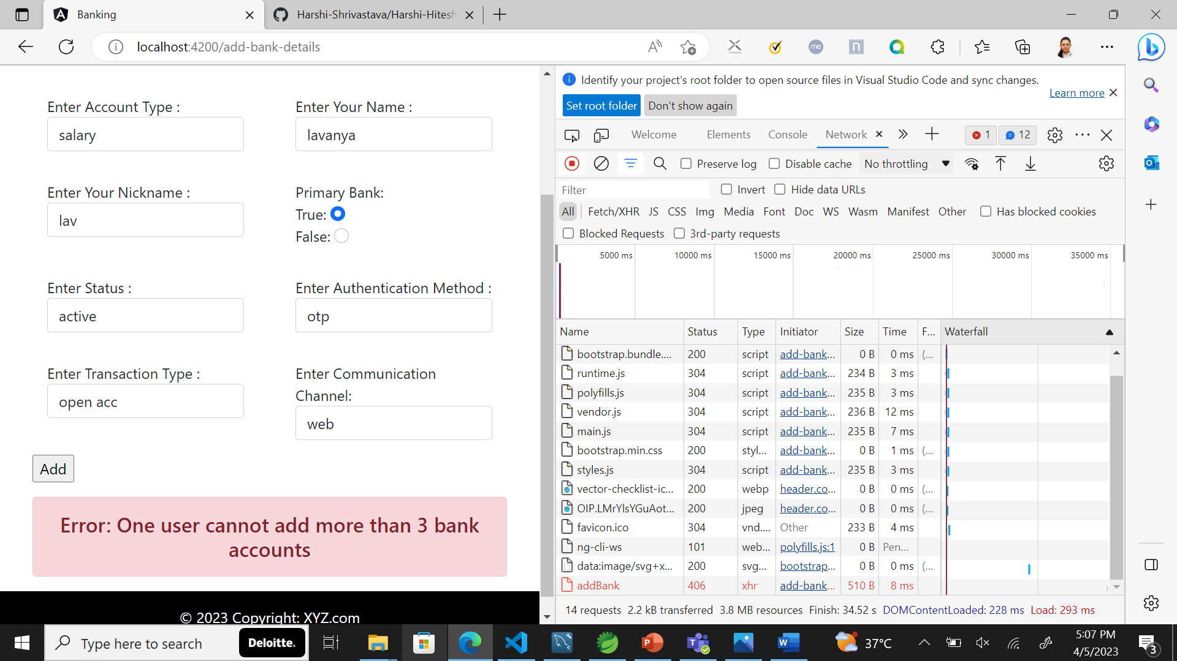
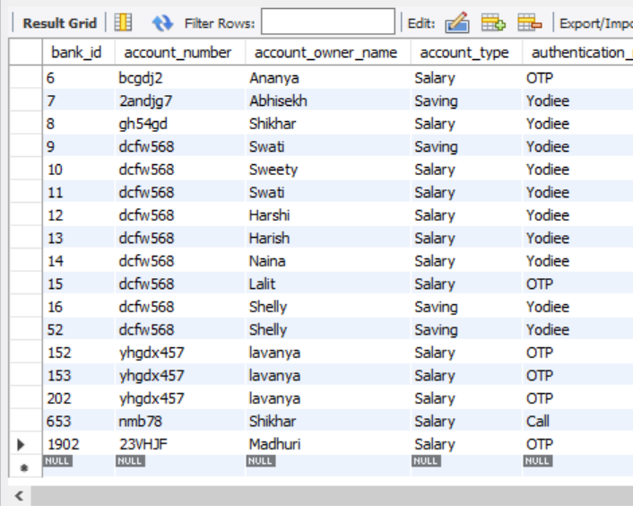
One user cannot add more than 3 bank accounts Response code 406
3 Lavanya present in database already

Slide 25
Security – JWT

Slide 26
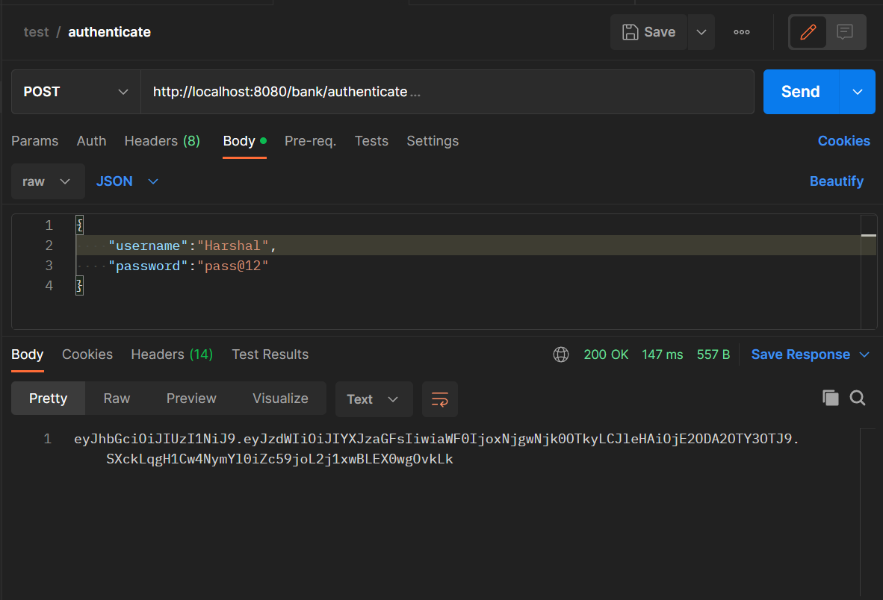
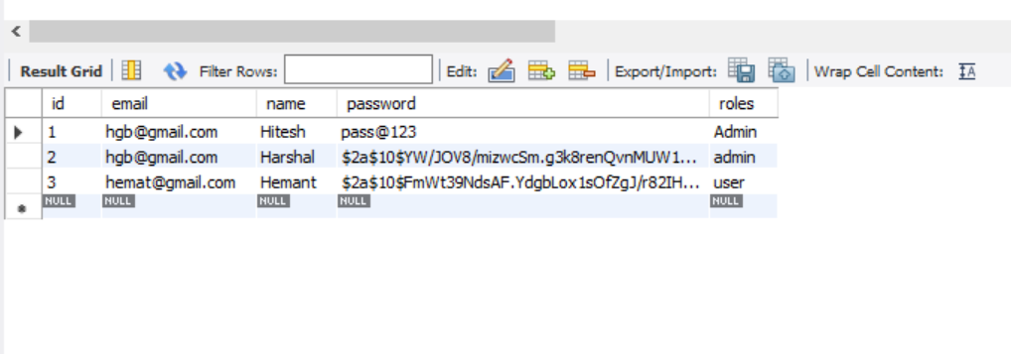
When given correct credentials token is generated

Slide 27
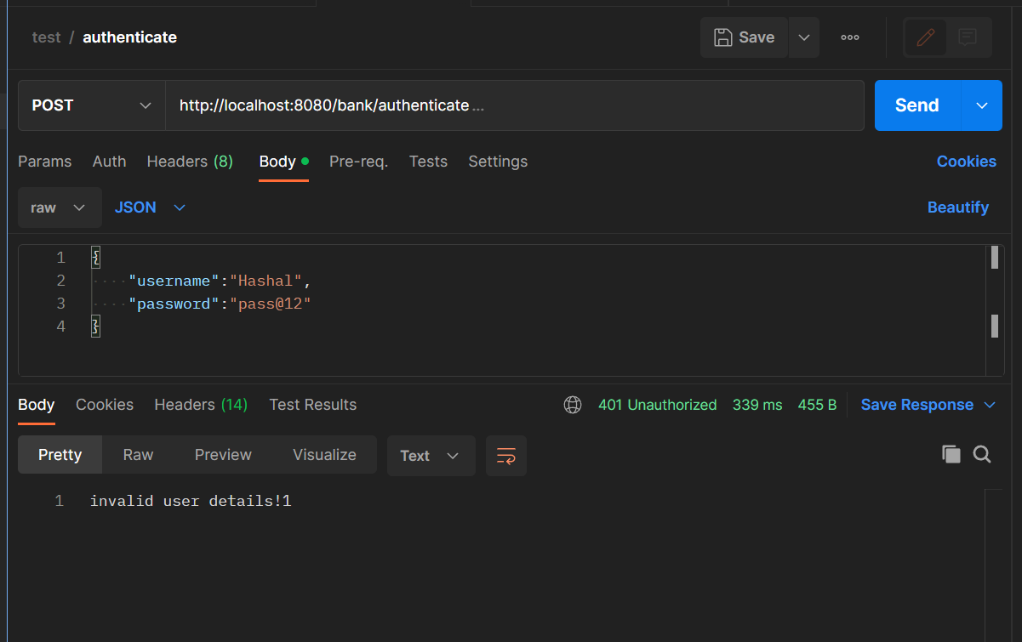
When given incorrect credentials – Response code 401.

